Slide 1
Transmission gear
Final project
DESN 204
By: Ambrosio Balbuena

Slide 2
Description
PN1210
Transmission gear, 2-speed spindle.
This gear goes on the spindle of the mini lathe and mini mill.
This is the larger of the two transmission gears. It has 21 Teeth on one end and 29 teeth on the other.
For CJ18 series mini-lathe & XJ12-300 mini-milling machines 21/29T

Slide 3
PN1207
Transmission gear, 2-speed intermediate shaft.
This gear goes on the intermediate shaft of the mini lathe and mini mill.
This is the smaller of the two transmission gears. It has 12 Teeth on one end and 20 teeth on the other.
For CJ18 series mini-lathe & XJ12-300 mini-milling machines - 12/20T

Slide 4
Milling and Drilling Machine MM-12

Slide 5
Broken Parts

Slide 6
sketches

Slide 8
CAD Drawings

Slide 10
3D printed replacement part

Slide 11
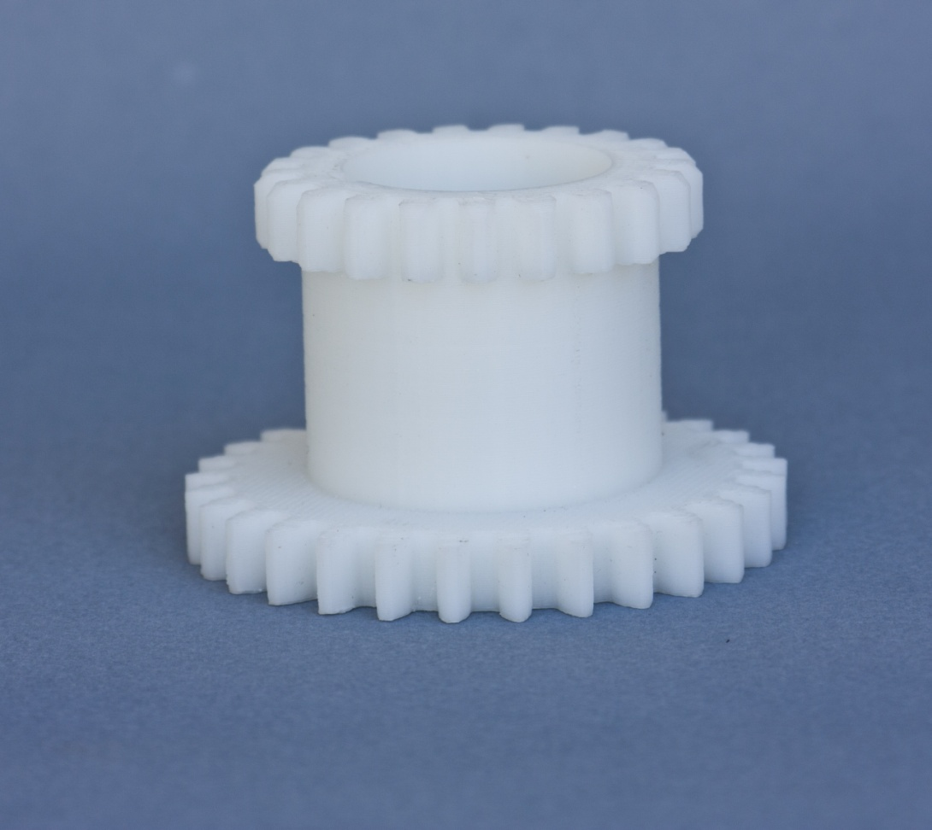
PN1210

Slide 12
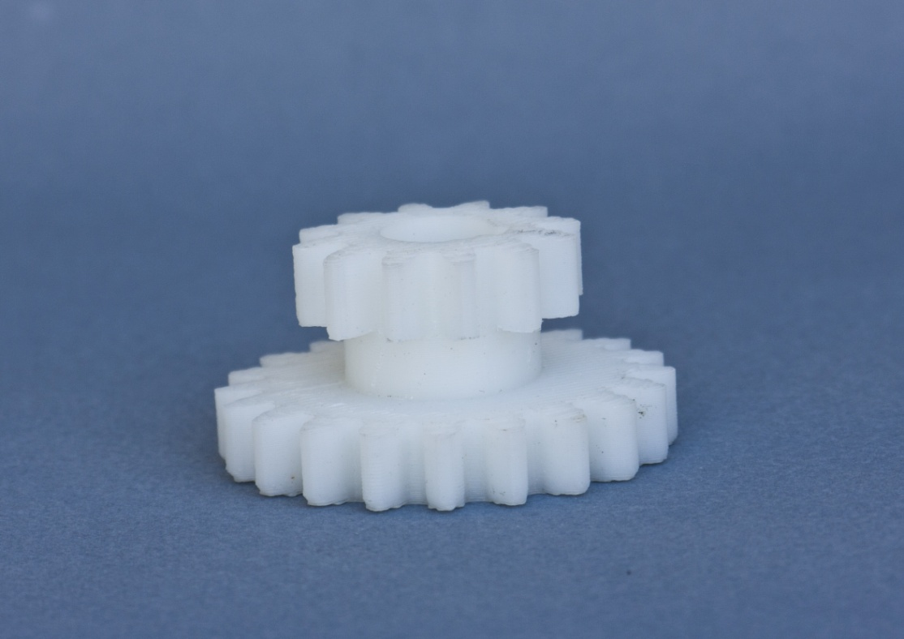
PN1207

